Slide 1
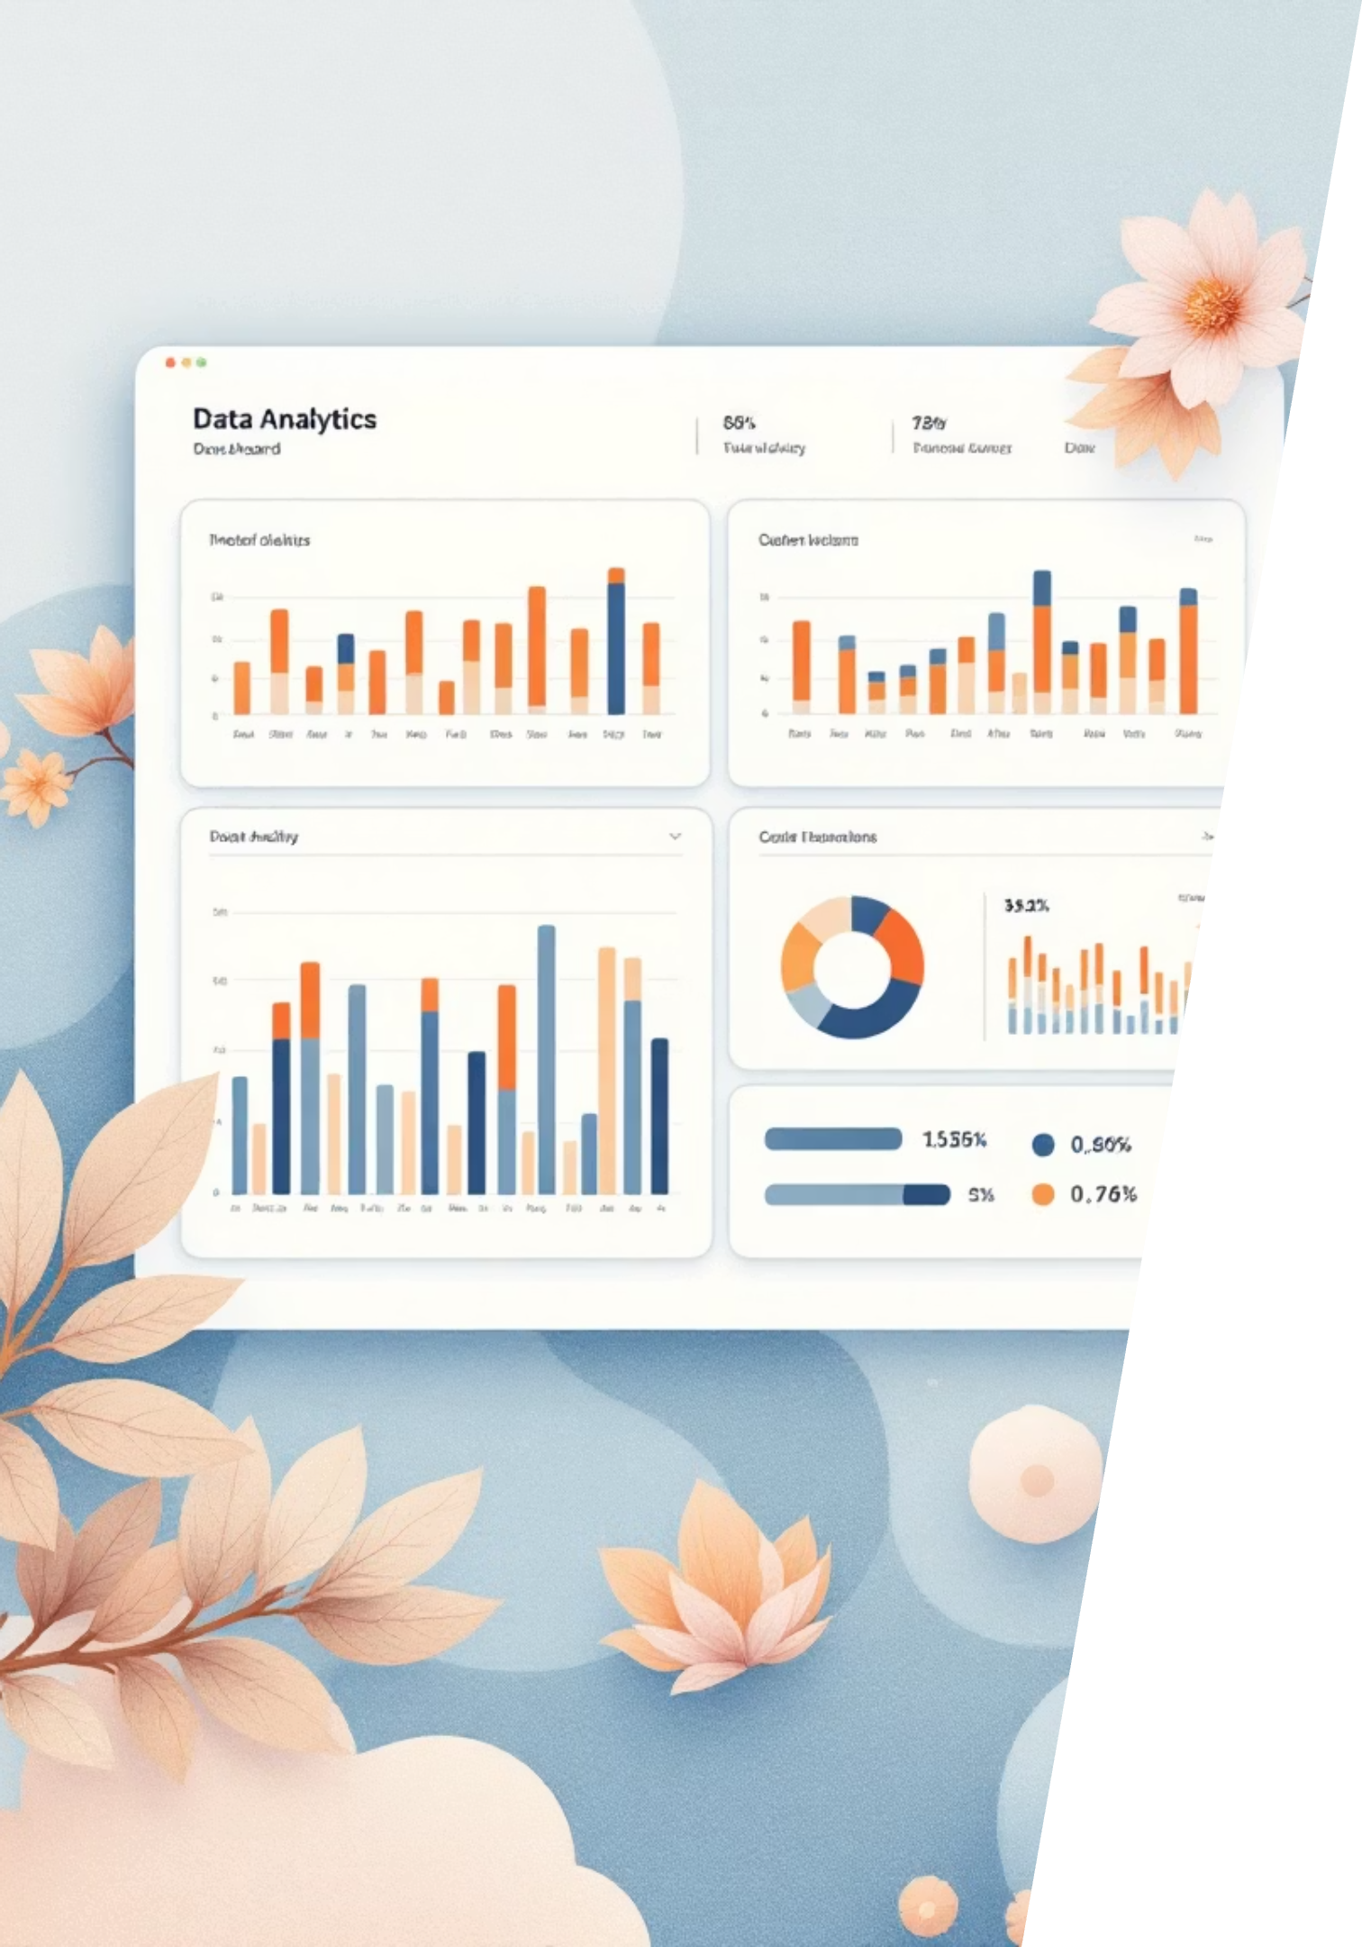
Zepto Database Analysis
A comprehensive SQL exploration of product inventory, pricing strategies, and business insights

Slide 2





Database Structure Overview
Core Schema
Pricing Data
Inventory Tracking
10 essential fields tracking SKU ID, category, name, pricing, and inventory metrics
MRP, discount percentage, and discounted selling price for revenue analysis
Available quantity, weight in grams, and out-of-stock status monitoring

Slide 3

Data Quality & Cleaning Process
01
02
Null Value Detection
Zero Price Removal
Comprehensive check across all fields to identify missing data points
Deleted products with MRP or selling price equal to zero
03
04
Currency Conversion
Duplicate Analysis
Converted paise to rupees by dividing prices by 100.0
Identified product names appearing multiple times with different SKUs

Slide 4

Inventory Status Snapshot
Stock Analysis
2
Products categorized by availability status, revealing critical inventory gaps and opportunities for restocking high-demand items.
Stock Categories
Distinct product categories organized alphabetically for streamlined catalog management and strategic merchandising decisions.
In-stock vs out-of-stock

Slide 5



Top 10 Best-Value Products
Products ranked by highest discount percentage, offering maximum savings to customers
1
2
3
Maximum Discount
MRP Comparison
Unique Products
Sorted by discount percentage in descending order
Original pricing displayed alongside discount rates
Distinct product names to avoid duplicates

Slide 6
Revenue & Pricing Insights
Category Revenue
High-Value Out of Stock
Premium Low-Discount
Estimated revenue calculated by multiplying discounted price by available quantity per category
Products with highest MRP currently unavailable, representing lost revenue opportunities
Products over ₹500 with less than 10% discount, targeting premium market segment

Slide 7

Top 5 Categories by Average Discount
Categories offering the highest average discount percentages to customers
Category Leaders
Rounded Precision
Ranked by average discount percentage across all products
Averages calculated to 2 decimal places for accuracy
Strategic Insights
Identifies categories with most aggressive pricing strategies

Slide 8

Weight-Based Product Analysis
Price Per Gram Optimization
Products above 100g analyzed for best value based on price per gram ratio, sorted to identify most cost-effective options.
Weight Categories
Low: Products under 1,000g
Medium: 1,000g to 5,000g
Bulk: Over 5,000g

Slide 9

Total Inventory Weight by Category
Comprehensive weight analysis revealing storage and logistics requirements across product categories
100%
Calculation Method
Weight in grams multiplied by available quantity per category
Results sorted by total weight to identify categories requiring maximum warehouse space and transportation capacity.

Slide 10


Key Takeaways & Business Impact
Data-Driven Decisions
Actionable Insights
SQL analysis enables strategic pricing, inventory optimization, and revenue forecasting across all product categories
Identified high-value out-of-stock items, best discount opportunities, and weight-based pricing strategies for competitive advantage
Operational Excellence
Comprehensive inventory tracking and category analysis support efficient warehouse management and customer satisfaction

